Slide 1
Roman Colosseum
Shamsul Arefin-011131156
Md.Abdullah Al Emran-011142150

Slide 2
Introduction
The Colosseum or Coliseum
also known as the Flavian Amphitheatre .
The Colosseum is situated just east of the Roman Forum. Construction began under the emperor Vespasian in AD 72, and was completed in AD 80 under his successor and heir Titus.

Slide 3
Introduction
Camera Control
Roll : Up and Down
Pitch : Q and E
Up-Down : PAGEUP and PAGEDOWN
Left-Right:A and D
Zoom in-out : W and S
Reset Camera : HOME

Slide 4
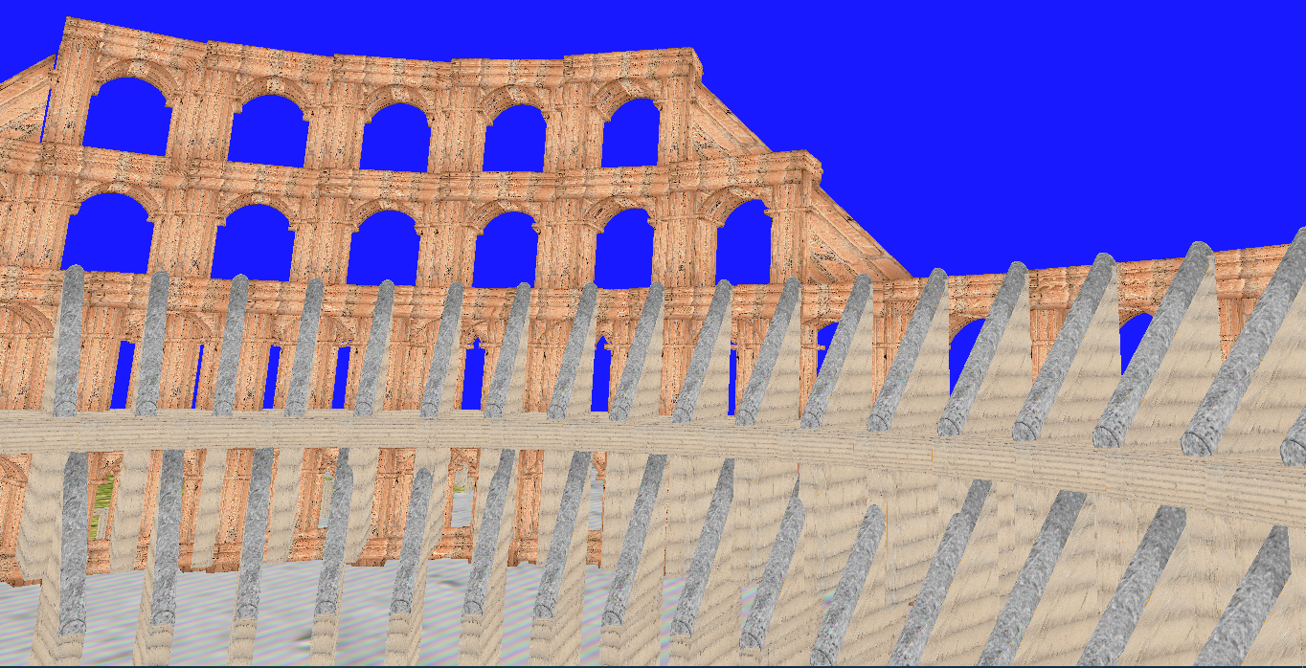

Slide 5
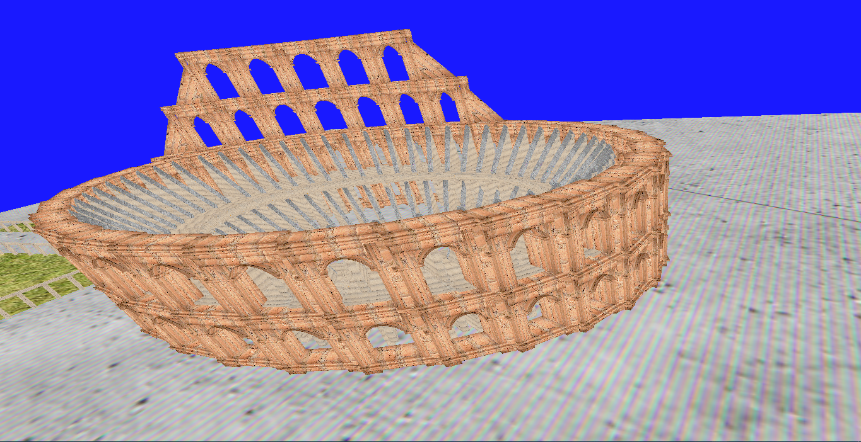

Slide 6
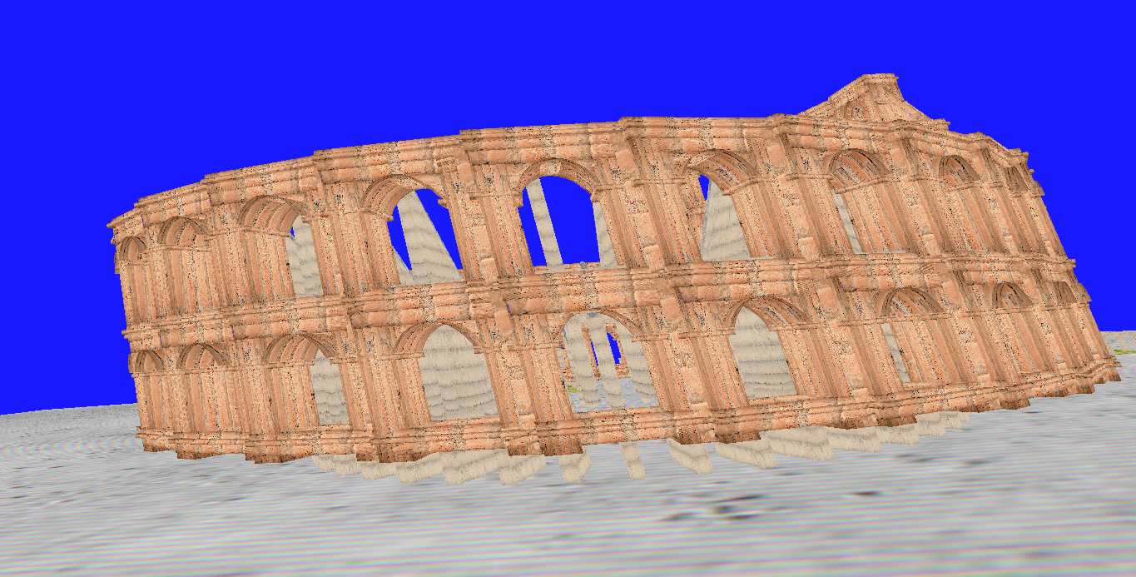

Slide 7
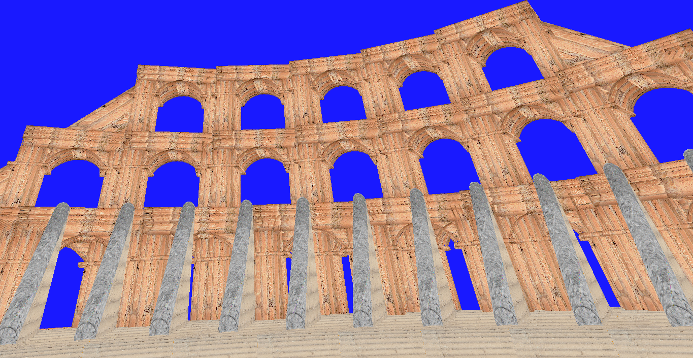

Slide 8
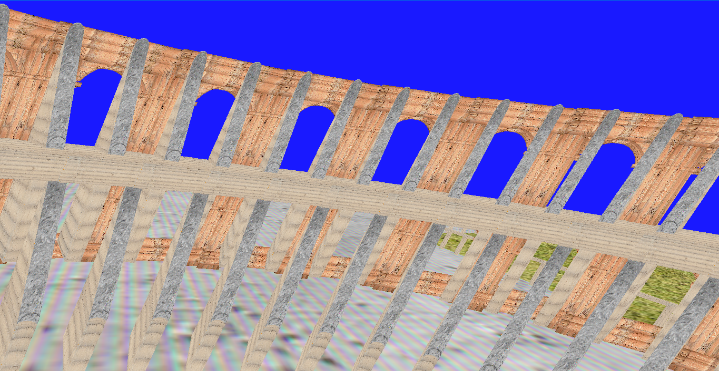

Slide 9
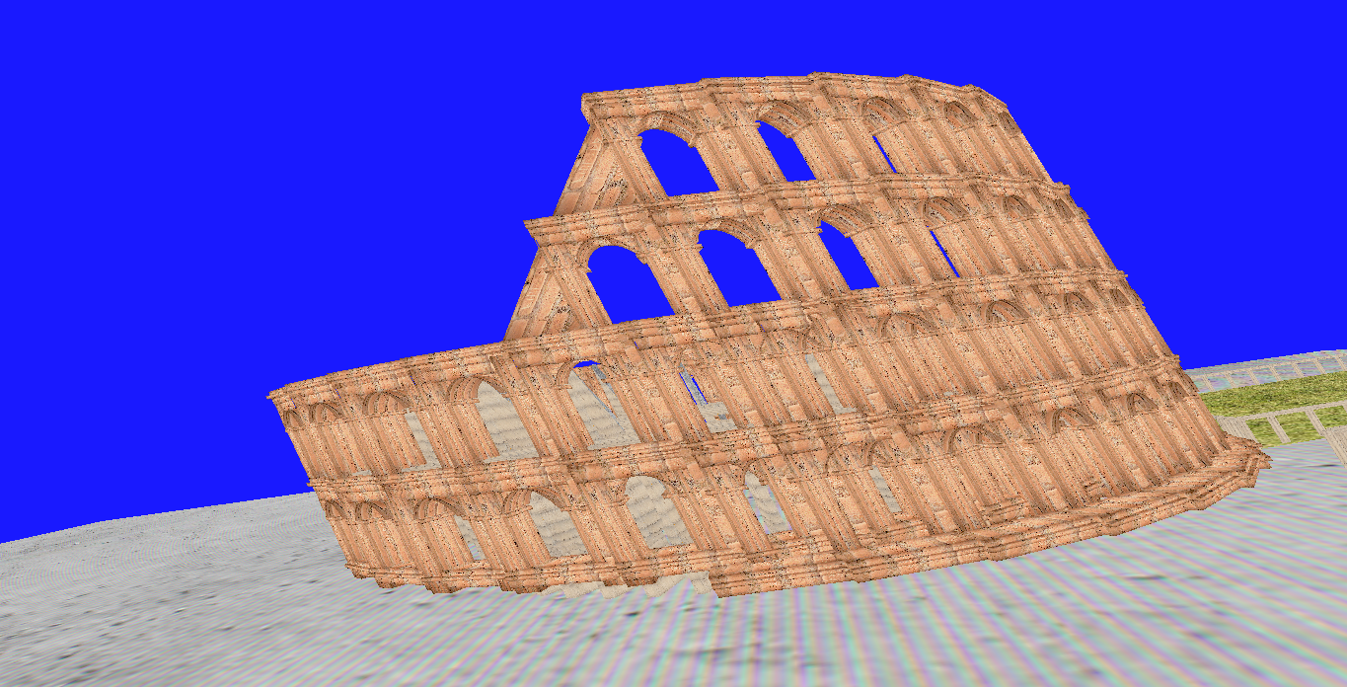

Slide 10
Thank You

